Slide 1

Predicting water pump function status in Tanzania
Bryan Spencer
https://github.com/brspencer90/water-pump-tanzania

Slide 2

What’s with water pumps in Tanzania?
43% of all Tanzanians do not have access to reliable and close water sources
Arid / semi-arid conditions across 1/3 of country
Gov. and private intervention to improve access had limited results until late 1990’s

Slide 3
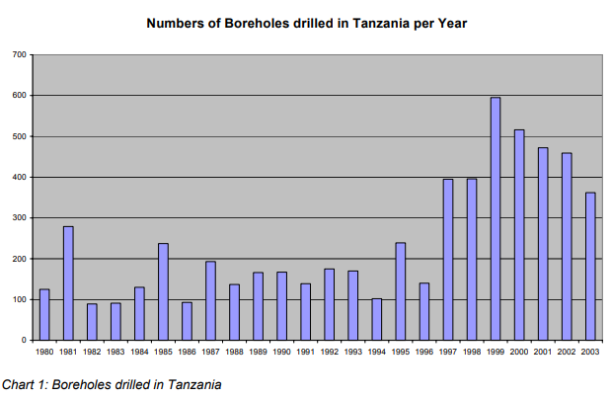
What’s the solution?
Ground water wells were identified to improve access to water in rural areas
Borehole drilling increased significantly since 1997 leading to more pumps.
More pumps mean more maintenance required to keep up water supply

Slide 4
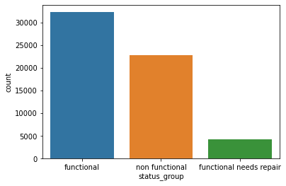
PREDICTING STATUS OF WATER PUMPs
How can we prevent pumps from falling into a non-functional state?
Repairs or replacement of non-functional pumps will cost more than preventative maintenance to functional pumps.
Objective : Optimise model to properly predict pumps that require repair

Slide 5
Data wrangling

Slide 6
What data will be used?
Water pump data
Geographic data
Taarifa Waterpoint Dashboard (inactive site – data stored on DrivenData.org)
From 1960 - 2013
Water Point Mapping Tanzania (wpm.maji.go.tz)
Updated dashboard with recent data
From the UN Humanitarian Data Exchange (data.humdata.org)
Shapefiles and region, sub-region data
Overall data
74,250 observations
Includes 14,850 test points for competiton
40 features
Overall data
510 observations
35 features
Notes:
What data will we use? The two subsets of data are the actual rig count data and the economic data.
The Rig Count Data comes from Baker Hughes – which has long been the standard for recording rig count data worldwide, and in the US. The data is available from 2011 to present and is available every week.
The economic data comes from the US Energy Intelligence Agency or EIA. Here we will have four subsets of data : oil price, USA storage and production data, OPEC and non-OPEC production data, and OECD and non-OECD consumption data. The frequency of this data varies from daily to monthly and have all been normalized to match the weekly rig count data.
Overall the data has 35 features and 510 observations.

Slide 7
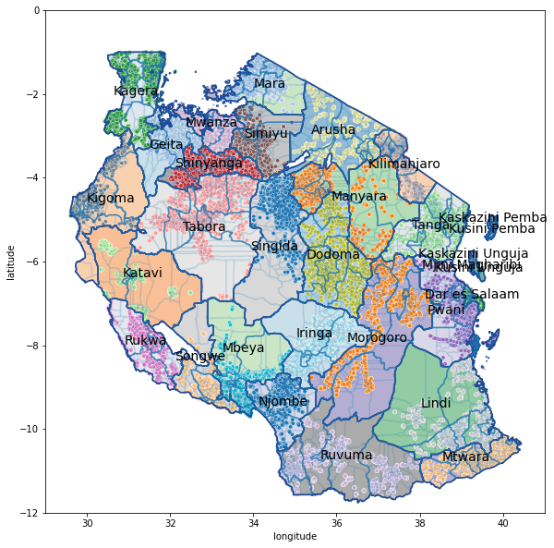
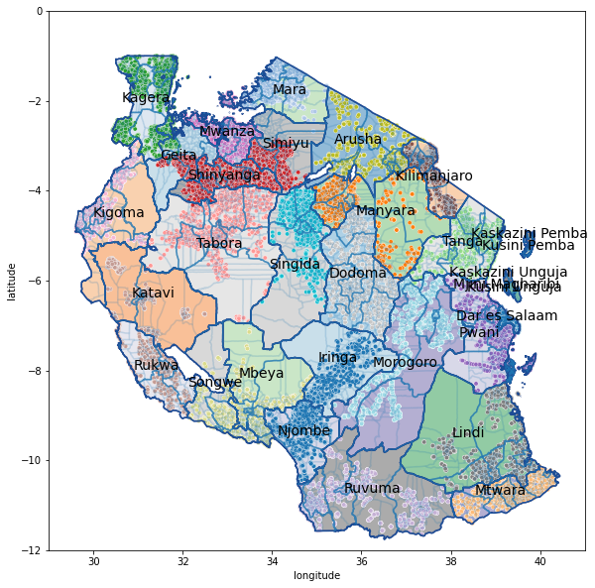
Geographic location correction
Mislabeled regions and sub-regions for water pumps
Location coordinates not within map boundaries
Could interfere with proper relationships with features
Used geopandas and shapefiles to correctly map the data points.

Slide 8
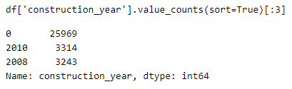
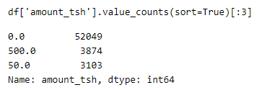
Data cleaning
Many features where data was improperly input
‘construction_year’ : zero values are clearly not valid
‘amount_tsh’ : refers to static head pressure at pump
Zero values could be valid and are not separatable from invalid values

Slide 9
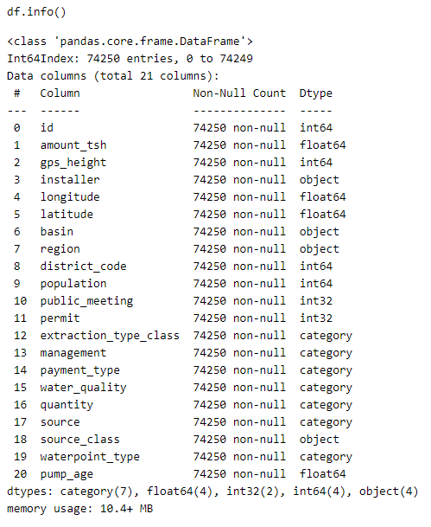
Final feature list and data set
Features reduced with considerations :
% of valid data points
Redundancies : region vs. region_code
Over specificity : LGA (sub-region) and wards (sub-LGA)
Features added :
pump_age = construction_year – date_visited

Slide 10
Exploratory data analysis & Data preprocessing

Slide 11
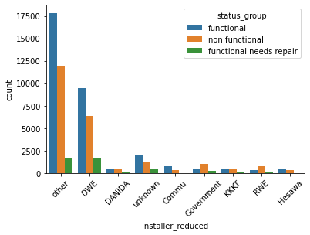

Exploratory data analysis
Many features with high cardinality – hard to interpret and visualize
Reduce cardinality of categorical variables by binning smaller variables into ‘other’ category

Slide 12
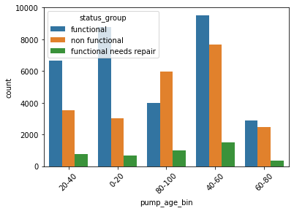
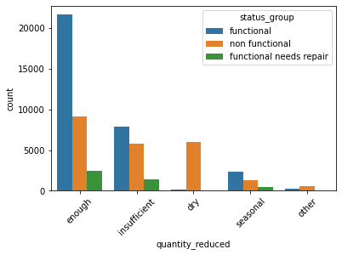
Exploratory data analysis
Notes:
Easier to differentiate between non functional / functional needs repair – harder to differentiate between functional / needs repair

Slide 13
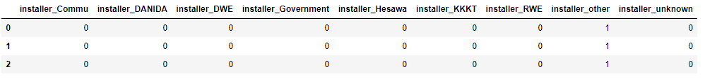
Pre-processing
Planning to use :
Random Forest Classifier
XGBoost
Keras Neural Network
Need to one-hot encode categorical variables for compatibility

Slide 14
modelling

Slide 15
Modelling process
Encoding classification labels
Data split into train and test set
33% test set
Model training
Grid Search for parameter optimization
5-fold cross validation
Model evaluation, selection, and performance
Multivariate classification scoring metrics

Slide 16
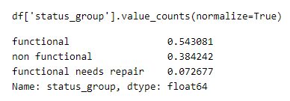
output variable distribution
How is ‘status_group’ distributed?
Significant imbalance, especially with ‘functional needs repair’
Will need to see if an over / under sampling method will help model performance

Slide 17
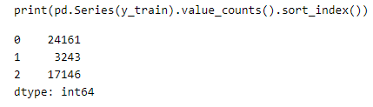
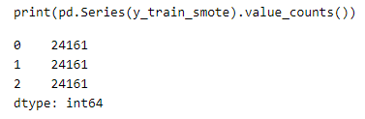
Train / test split & label balance
sklearn train_test_split function used
25% test size
SMOTE oversampling method used to balance the output labels

Slide 18
Model training
Establish baseline :
Random Choice from distribution
Models used :
Random Forest Classifier
XGBoost
Keras Neural Network

Slide 19
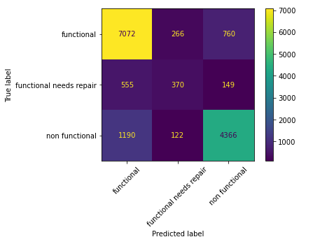
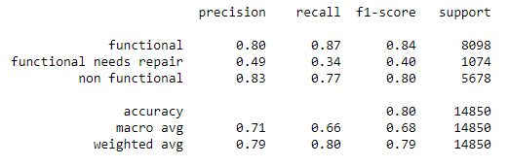
Model evaluation
Multivariate classification scoring metrics :
Accuracy
Precision
Recall

Slide 20
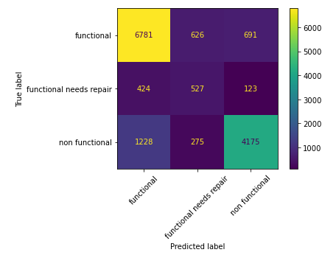
Model selection
 | Accuracy | Needs Repair Precision | Needs Repair Recall
RFC Base | 80% | 49% | 34%
RFC SMOTE | 79% | 43% | 43%
XGBoost Base | 79% | 47% | 37%
XGBoost SMOTE | 77% | 37% | 49%
NN SMOTE | 75% | 33% | 42%
Notes:
Here is a table of all the models that were trained. The baseline dummy classifier performs slightly better than random choice, while Kmeans performs worse than the dummy classifier. This shows that the data are not grouped and requires a more complex analysis.
The Random Forest Classifiers and XGBoosts were optimized with different metrics, as well as their base model performance. The Random Forest Classifier using the positive negative classification metric to during parameter tuning provided the best performance.
The confusion matrix is shown on the right.

